Slide 1
DEBARK UNIVERSITY
COLLAGE OF NATURAL AND COMPUTATIONAL SCINCE DEPARTMENT OF COMPUTER SCINCE
COURSE TITLE:WEB PROGRAMMING
GROUP TWO (2)
NAME ID
1 WORKYE YETEMEGN………………..…....1600936
2 ASNAKEW MISGANEW……………..….…..1600638
3 MEKDES ABABU……………………….…...1600819
4 ENDEGENA MOLLA ……………………….1602043
5 ZEMENAY AYELGEN………………………1600972
Submitted to: MR : YESHAMBEL A.
Submission Date:14/07/2018 E.C
DEBARK ETHIOPIA

Slide 2
Project Title:
Digital Supply Chain Management for Fertilizer Distribution.

Slide 3
System Overview
Purpose: Track fertilizer inventory, distribution, and shipments from central warehouses to farmers in the Debark region.
Target Users: Admin, Supplier, Retailer, and Customer (Farmer) roles.
Core Benefits:
  Real‑time inventory visibility
  Distribution tracking by region and fertilizer type
  Shipment monitoring with status updates
  Comprehensive reporting and analytics
  Role‑based access control

Slide 4
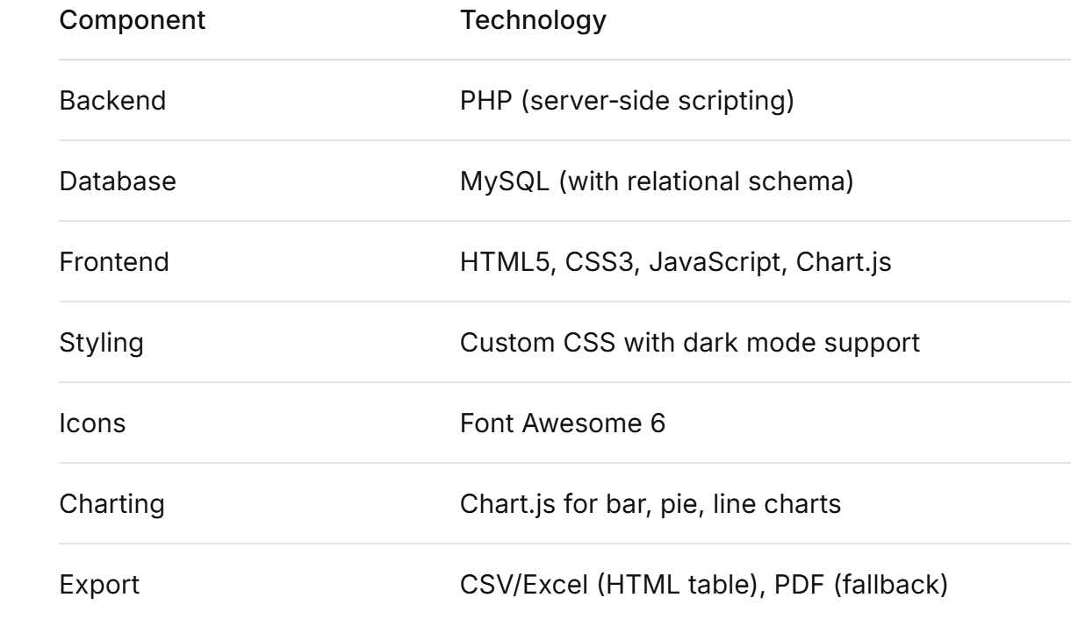
Technology Stack

Slide 5
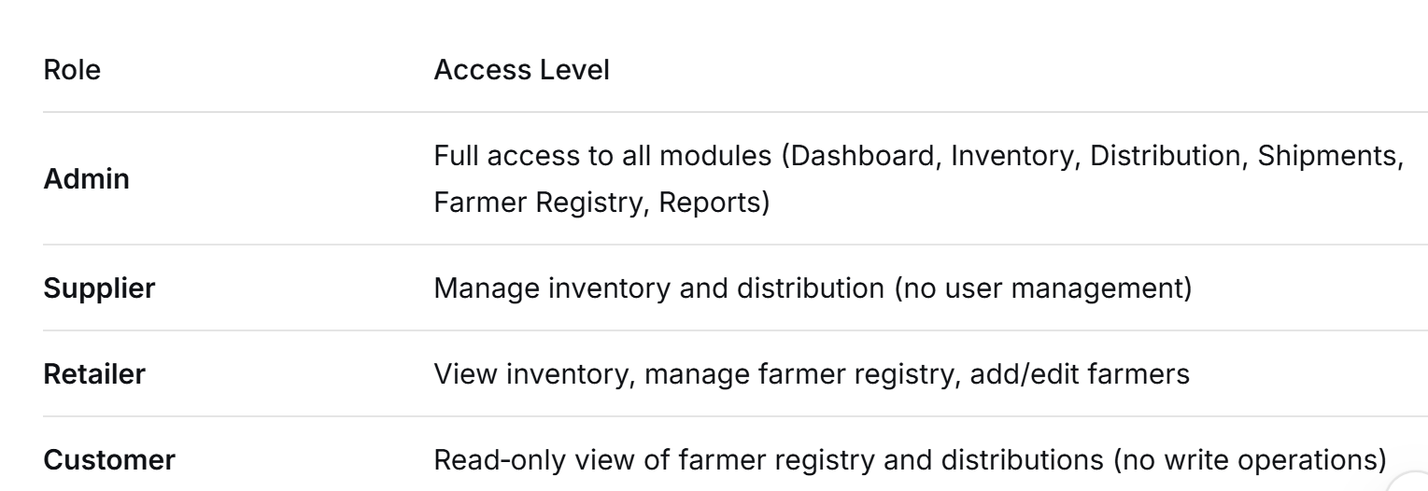
User Roles & Access Rights

Slide 6
Dashboard (Admin View)
Key Metrics Cards:
  Total stock in quintals
  Monthly distributed quantity
  Number of registered farmers
  Active shipments

Slide 7
Inventory Management
Features:
  Add, edit, delete inventory records (Admin/Supplier only)
  Track fertilizer type, quantity (quintals), warehouse location
  Statistics: total batches, total stock, warehouse count, DAP/Urea totals
Data Validation:
  Quantity must be positive integer
  Fertilizer type from predefined list (DAP, Urea, NPS, NPSB)
  Warehouse from dropdown (Debark Central, Gondar Hub, etc.)
Responsive Table with inline action buttons

Slide 8
Distribution Tracking
Form to record new distributions:
  Region (letters/spaces/hyphens only)
  Fertilizer type (select)
  Quantity (positive integer, min 1 Qtl)
  Distribution date (defaults to today)
  Status (Pending, Delivered, Leakage Alert)

Slide 9
Table showing all distributions with delete option (Admin/Supplier)
Validation:
  Server‑side: region regex, quantity >0 and integer
  Client‑side: real‑time feedback for quantity and region
Shipment Management
Add Shipment (Admin only):
  Truck plate, driver name, region, woreda, hub, ETA, status
Table of shipments with status badges (In‑Transit, Delivered, Delayed)

Slide 10
Actions:
  Change status (Admin)
  Delete shipment
Statistics Cards:
  Total shipments, in‑transit, delivered, delayed
Validation: all fields required, ETA free text

Slide 11
Farmer Registry
Purpose: Register smallholder farmers with land size and calculate fertilizer requirement (land × 3 Qtl/ha)
Fields:
  Region (dropdown), full name, woreda, kebele, land size (hectares)
  Auto‑generated farmer ID (e.g., FARM-2025-XXXX)
  Status (Active/Inactive)
Statistics Cards:
  Total farmers, active farmers, total land, total requirement, regions covered

Slide 12
Permissions:
  Admin/Retailer: add, edit, delete, toggle status
  Customer: view only
Reports & Analytics
Filters: Date range, region, report type
Export Options:
  Excel (.xls) – server‑generated HTML table
  PDF – dynamic HTML with print styling or optional mPDF
  Print – browser print dialogue

Slide 13
Tabs:
  Summary: Regional pie chart, monthly trend line, key stats
  Distribution: Regional breakdown, monthly performance
  Inventory: Stock by fertilizer type, warehouse summary
  Farmers: Farmer counts by region, land/requirement stats

Slide 14
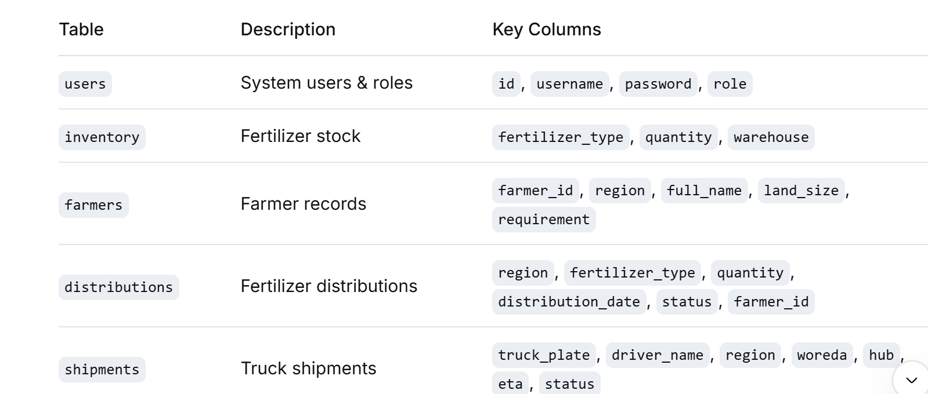
Database Schema (Key Tables)

Slide 15
UI Highlights
Dark Mode Toggle: User preference saved in cookie, applies globally
Sidebar Collapse: Responsive design, collapses on mobile
Alert Messages: Auto‑hide after 3 seconds (success/error/warning)
Modal Forms: Used for adding farmers and shipments.

Slide 16
Deployment Instructions
Import database.sql into MySQL (create database fsc_inventory).
Configure db_connect.php with your database credentials.
Place all files in a web server directory (e.g., htdocs/fsc).
Access index.php to view the landing page.
CHECK MANAGER SAMPLE:
  Admin: admin / admin123
  Supplier: supplier / supplier123
  Retailer: retailer / retailer123
  Customer: customer / customer123

Slide 17
Future Enhancements
Real‑time GPS tracking for shipments
SMS alerts to farmers when fertilizer arrives
Mobile‑first PWA for field agents
Leakage detection using AI on distribution patterns
Integration with Ethiopian Agricultural Transformation Agency (ATA) data feeds
Multi‑language support (Amharic, English)

Slide 18
Conclusion
A complete, role‑based web application for managing the fertilizer supply chain in Debark, Ethiopia.
Enables transparent tracking of inventory, distribution, and shipments.
Empowers different stakeholders with appropriate access.
Built with open‑source technologies, easy to extend and deploy.

Slide 19
THANK YOU
THE END !!!

